Slide 1
Pandas 1 pandas input and output
Andrew Beatty
Andrew.Beatty@gmit.ie
Programming for Cybersecurity

Slide 2
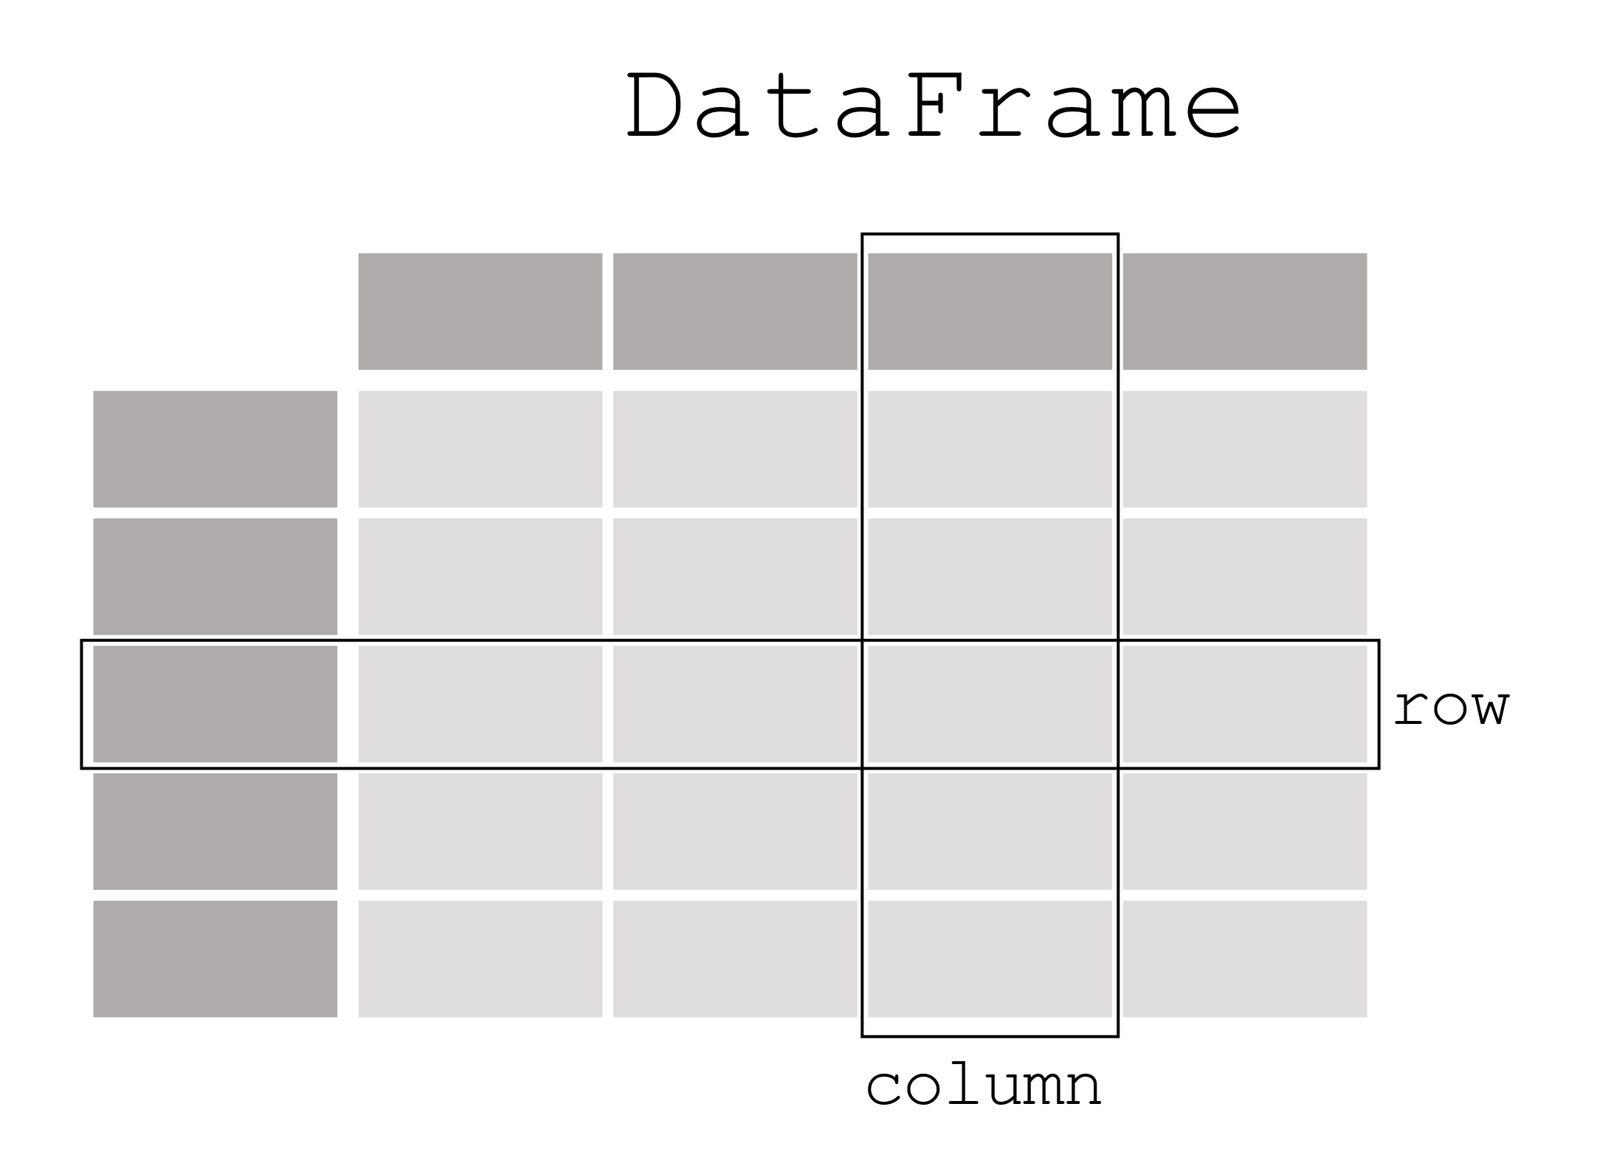

What iS pandas used for?
Analysing data that is in a tabular form
Column Name
index
index
Data
Images from pandas.pydata.org

Slide 3
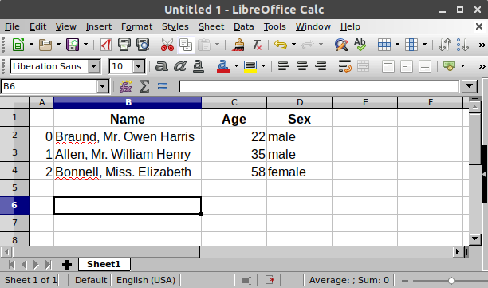
Like a spreadsheet
Columns have data types
index

Slide 4
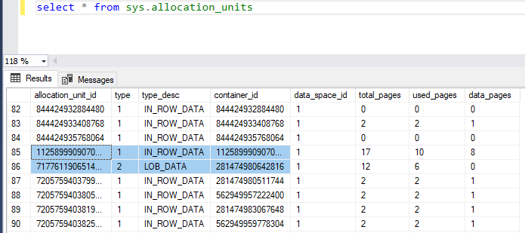
Or a table in a relational database
Column name/ attribute name
Index
Except indexes do not have column names
Columns have data types

Slide 6
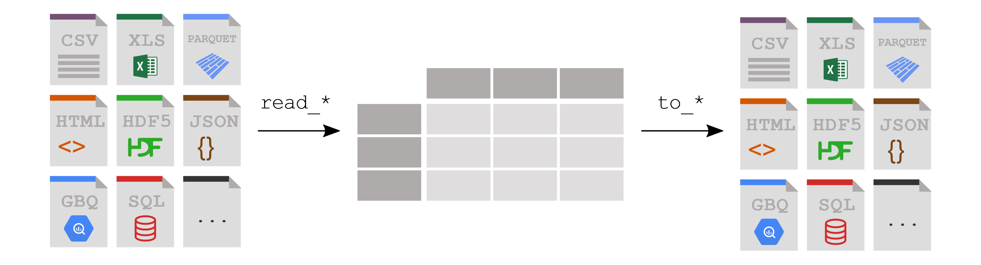
Reading and writing to Pandas
Or as Dictionary and list structures.
(or numpy arrays)

Slide 8
Don’t worry if you don’t get these concepts yet

